Slide 1
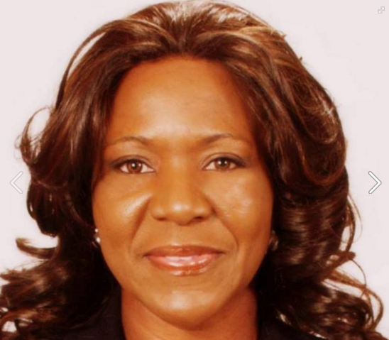
History maker . Generational curse breaker . Author . Wife . Mother
Hope Alive World Outreach Ministries www.exposingthepain.com
When: Friday, October 30 at 6:30 pm
Saturday, October 31 at 6:30 pm
Sunday, November 1 at 11 am
Where: 28000 New Market Rd, Farmington Hills, MI 48334
MARANATHA EVANGELISTIC MINISTRIES
28000 New Market Rd, Farmington Hills, MI 48334

